Slide 1
URINARY ELIMINATION

Slide 2

Normal Urination : The healthy adult excrete about 1500 ml of urine a day, many factors affect urine production :
Age
Disease
The amount and kind of fluid ingested.
Dietary salt
Drugs.

Slide 3
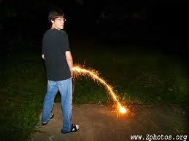
Urination, micturition and voiding mean the process of emptying urine from the bladder. It depends of many factors :
The amount of fluids intake
Personal habits.
Available toilet facilities.
Works
Illness

Slide 4

People usually urinate :
At bed time
After getting up
Before meals
When take a bath
Some people urinate every 2 to 3 hours.
The need to urinate at night disturbs sleep.

Slide 5

Observations :
Urine is normal pale yellow, straw colored or amber
It is clear with no particles.
A faint odor is normal
Observe color, clarity, odor, amount and particles.

Slide 6

Rules for maintaining normal elimination :
Practice medical asepsis and Standard Precautions. Also follow the Bloodborne Pathogen Standard
Provide fluids as instructed by the nurse
Follow the person’s normal voiding routines and habits. Checks with the nurse and the nursing care plan.

Slide 7

Help the person to the bathroom when the request is made. Or provide the commode, bedpan or urinal. The need to void may be urgent.
Help the person assume a normal position for voiding if possible. Women seat on squat; men stand.
Warm the bed pan or urinal
Cover the person or warmth and privacy.

Slide 8
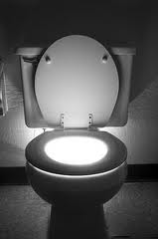
Provide for privacy. Pull the curtain around the bed, close room and bathroom door and pull drapes or window shades. Leaves the room if the person can be alone.
Tell the person that running water, flushing the toilet or playing music can mask urination sounds. Some persons are embarrassed about voiding with others close by.
Remain nearby if the person is weak or unsteady.

Slide 9

Place the signal light and toilet tissue within reach.
Allow the person enough time to void. Do not rush the person.
Promote relaxation. Some people like to read when eliminating.
Run water in a nearby sink if the person has difficulty starting the stream. Or place the person’s fingers in some warm water.

Slide 10
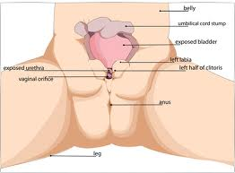
Provide perineal care as needed.
Have the person wash her or his hands after voiding. Provide a wash basin, soap, washcloth and towel, Assist as necessary.
Assist the person to the bathroom or offer the bedpan, urinal, commode at regular time. Some people are embarrassed or are too weak to ask

Slide 11
Common Urinary Elimination Problem.
Problem | Definition | Causes
Dysuria | Painful or difficult urination | Urinary tract infection, trauma, urinary, tract obstruction.
Hematuria | Blood In the urine | Kidney disease, urinary tract infection, trauma.
Nicturia | Frequent urination at night | Excessive fluid intake, kidney disease, prostate disease.,
oliguria | Scant amount of urine usually less than 500 ml in 24 hours | Inadequate fluid intake, shock, burns, kidney disease, heart failure.
Polyuria | The production of abnormality large amounts of urine | Drugs, excessive fluid intake, diabetes mellitus, hormone imbalance

Slide 12
Urinary frequency | Voiding at frequent intervals | Excessive fluid intake, bladders infections, pressure of the bladder, drugs.
Urinary incontinence | Inability to control the loss of urine from the bladder | Trauma, disease, urinary tract infections, reproductive or urinary tract surgeries, aging, fecal impaction, constipation, not getting to the bathroom.
Urinary urgency | The need to void immediately | Urinary tract infection, fear of incontinence, full bladder, stress.

Slide 13
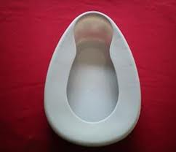
Bedpan are used when persons cannot be out of bed. Women use bedpans for voiding and bowel movements, men used them only for bowel movements. They are made of plastic or stainless steel. You could warm it before use with water and dried.
There is two kind: fracture pan has thinner rim and is only about ½ inch deep on the end. And bedpan described.

Slide 14
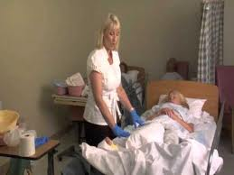
Giving the bedpan:
Pre-Procedure :
Provide for privacy
Put on gloves
Collect the following :
Bedpan
Bedpan cover
Toilet tissue.
Arrange equipment on the chair or bed
Explain the procedure to the person
Rise the bed to the best level for good body mechanics. Make sure bed rails are up

Slide 15

Procedure :
Warm and dry the bedpan if necessary.
Lower the bed rail near you.
Position the person supine. Raise the head of the bed slightly.
Fold the top linens and gowns out of the way. Keep the lower body covered.
Ask the person to flex the knees and raise the buttocks by pushing against the mattress with his or her feet.

Slide 16
Slide your hand under the lower back and help him or her rise the buttocks.
Slide the bedpan under the person.
Do the following if the person cannot assist in getting on the bedpan:
Turn the person onto the side away from you
Place the bedpan firmly against the buttocks
Push the bedpan down and toward the person
Hold the bedpan securely. Turn the person onto the back. Make sure the bedpan is centered under the person.

Slide 17
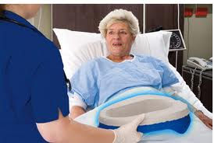
Return top linens to their proper position.
Raise the head of the bed so the person is in a sitting position.
Make sure the person is correctly positioned on the bedpan.
Raise the bed rail.
Place the toilet tissue and signal light within reach.
Ask the person to signal when done or when help is needed

Slide 18
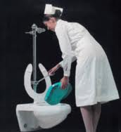
Remove the gloves and wash your hands.
Leave the room and close the door
Return when the person signals. Knock before entering
Lower the bed rail and the head of the bed.
Put on gloves

Slide 19

Ask the person to raise the buttocks. Remove the bedpan. Or hold the bedpan securely and turn him or her onto the side away for you.
Clean the genital area if the person cannot do so. Clean from front to back with toilet tissue.. Use fresh tissue to each wipe. Provide perineal care if necessary.
Cover the bedpan. Take it to the bathroom or dirty utility room. Raise the bed rail before leaving the bedside

Slide 20
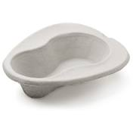
Note the color, amount and character or urine or feces.
Empty and rinse the bedpan. Clean it with a disinfectant.
Remove soiled gloves. Wash your hands and put on gloves.
Return the bedpan and clean cover to the bedside stand.
Help the person wash the hands
Remove the gloves.

Slide 21
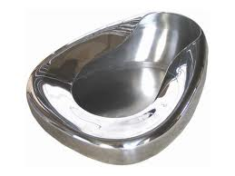
Post-Procedure:
Provide for comfort
Place the signal light within reach.
Raise or lower bed rails. Follow the care plan.
Lower the bed to its lowest position
Unscreen the person
Follow agency policy for soiled linen
Wash your hand.
Report your observations to the nurse.

Slide 22

Urinals : Men use urinals to void. Plastic urinals have caps at the top and hook-type handles. The urinals hook to the bed rail within the man’s reach. The man stands to use the urinal if possible. You may have to place and hold the urinal for some men. Remind the man not to place urinals on over bed table and bedside stands.

Slide 23
Giving the urinals.:
Procedure:
Provide for privacy
Determine if the man will stand or stay in bed.
Put on gloves
Give him his urinal if he is in bed. Remind him to tilt the bottom down to prevent spills
Do the following if he is going to stand :
Help him sit on the side of the bed.
Put shoes on nonskid slippers on him
Assist him to standing position
Provide support if he is unsteady.
Give him the urinal

Slide 24

Position the urinal between his legs if necessary. Position his penis in the urinal if he cannot hold the urinal.
Cover him to provide for privacy.
Place the signal light within reach. Ask him to signal when done or when he needs help.
Remove the gloves and wash your hands

Slide 25
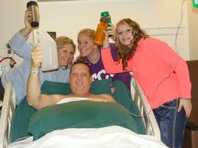
Leave the room and close the door
Return when he signals for you, Knock before entering.
Put on gloves
Cover the urinal. Take it to the bathroom or dirty utility room
Note the color, amount and character of the urine

Slide 26

Empty the urinal, and rinse it with cold water. Clean it with a disinfectant
Return the urinal to the bedside stand
Remove soiled gloves. Wash your hands and put on clean gloves.
Help the person wash his hands
Remove the glove.

Slide 27
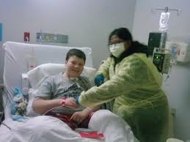
Post-Procedure:
Provide for comfort
Place the signal light within reach.
Raise or lower bed rails. Follow the care plan
Unscreen him
Follow agency policy for soiled linen
Wash your hands.
Report your observations to the nurse.

Slide 28
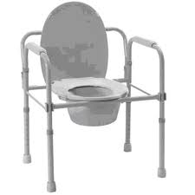
Commodes : A bedside commode is a portable chair or wheelchair with an opening for a bedpan or container. :Person unable to walk to the bathroom also use commode. The commode allows a normal position for elimination. The bedpan or container is cleaned after use like a regular bedpan.

Slide 29
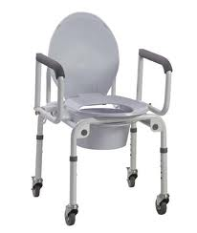
Helping the person to the commode :
Pre-Procedure :
Explain the procedure to the person
Provide for privacy
Put on gloves
Collect the following :
Commode
Toilet tissue
Bath blanket

Slide 30
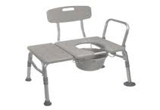
Procedure:
Bring the commode next to the bed. Remove the chair seat and lid from the container.
Help the person sit on the side of the bed.
Help him or her put on a robe and shoes and nonskid slippers
Assist the person to the commode.
Place a bath blanket over his or her lap for warmth

Slide 31
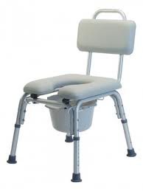
Place the toilet tissue and signal light within reach.
Ask him or her to signal when done or when help is needed
Remove the gloves and wash your hands.
Leave the room and close the door( Stay in the room if it is not safe to leave the person alone, Allow as much privacy as possible)

Slide 32
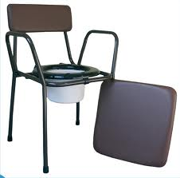
Return when the person signals. Knock before entering.
Put on the gloves
Help the person clean the genital area if indicated. Remove the gloves
Help the person back to bed. Remove the robe and slippers. Raise the bed according to the care plan.

Slide 33
Put on clean gloves. Cover and remove the container from commode. Clean the commode if necessary.
Take the container to the bathroom or dirty utility room.
Check urine and feces for color, amount and character.
Clean and disinfect the container
Return the container to the commode. Return other supplies top their proper place.

Slide 34
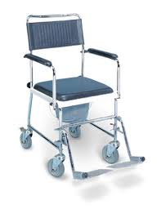
Remove soiled gloves.
Wash your hands and put on clean gloves
Help the person wash the hands.
Remove the gloves

Slide 35
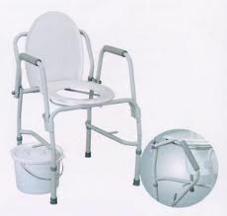
Post-Procedure:
Provide for comfort
Place the signal light within reach.
Raise or lower bed rails. Follow the care plan.
Unscreen the person
Follow agency policy for soiled linen
Wash your hands.
Report your observations to the nurse.

