Slide 1
BASIC LIFE SUPPORT

Slide 2
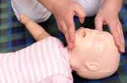
BLS FOR Infant and Children:
Cardiac arrest is rare in children. More common causes involves diseases and injuries that lead to respiratory arrest or circulatory failure:
SIDS: Sudden Infant Death Syndrome.
Respiratory diseases.
Airway obstructions.
Drowning.
Infections.
Nervous System Diseases.
Injuries ( accident-burns- drowning-firearm)

Slide 3
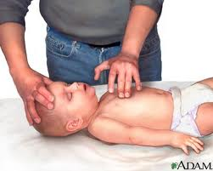
Sequence of BLS
Determining unresponsiveness, activating the EMS system and determining breathlessness and pulselessness. Differences for adult procedures :
Injuries are the likely cause of respiratory or cardiac arrest. Head, neck and spinal cord injuries are possible. Therefore do not move or shake the child to determine responsiveness. Check unresponsiveness by tapping or shouting to get response.

Slide 4
Sequence of BLS
Differences for adult procedures :
Shout for help or send a second rescuer to activate the EMS system.
If you are alone provide basic life support for 1 minute before activating the EMS system. This can prevent respiratory arrest for advancing to cardiac arrest.
If there are not injuries and if the person is small, carry the person to the telephone. This makes calling the EMS system easier

Slide 5
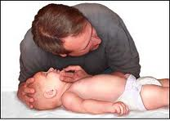
Sequence of BLS
Differences for adult procedures :
Move any person from a dangerous location. Also move the person if you cannot perform CPR where the person is lying.
If you must move the person, make sure the head does not roll, twist or tilt . Hold the head and body straight without twisting. Use the logrolling procedure to turn the person.
Use the head-tilt/Chin-lift maneuver for infant and children. Do not hyperextend the head as in the adult. Rather tilt the head to a normal(neutral) or sniffing position.

Slide 6
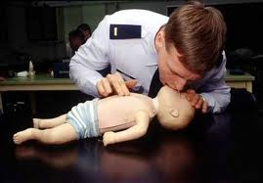
Sequence of BLS
Differences for adult procedures :
If neck injury is suspected, use the jaw-thrust maneuver.
Place 2 or 3 fingers under each side of the lower jaw and the angle of the jaw.
Use your other finger to lift the jaw upward and outward.
Rest your elbows on the surface on which the infant or child is lying

Slide 7
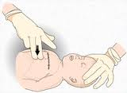
Sequence of BLS
Differences for adult procedures :
Keep the airway open through CPR. Only use hand for chest compressions. Keep the other hand on the forehead to maintain the head tilt . For children , use both hands for the head-tilt/chin-lift.
In children under 1 year of age, use the brachial pulse to determine pulselessness.
Give 20 breaths and 100 chest compressions per minute.

Slide 8
CPR for Infants and Children ( under 8 years old):
Procedure:
Check for unresponsiveness.
Active the EMS system if help is available Otherwise, activate the EMS system after 1 minute of CPR.
Logroll the child onto his or her back. Support the head and neck when turning the child. Position the child supine on a hard, flat surface.
Open the airway. Use a head-tilt/chin-lift maneuver. Do not hyperextend the head. Extension of the head usually opens an infant’s or child airway.

Slide 9
CPR for Infants and Children ( under 8 years old):
Procedure:
Check for breathlessness.
Give two low breath. Use enough force to make the chest rise. Take 1 to ½ seconds for each breath. Cover and infant’s nose and mouth with your mouth when giving a breath. Lets the chest deflate between breaths.
Check for pulselessness. Use the brachial artery for infants and the carotid artery for children. Keep the airway open.

Slide 10
CPR for Infants and Children ( under 8 years old):
Procedure:
Give chest compressions to an infant:
Locate hand position :
Draw an imaginary line between the nipples.
Place your index finger just under the imaginary line
Place your middle and ring fingers next to your index finger. The area for chest compression is below your middle and ring fingers.

Slide 11
CPR for Infants and Children ( under 8 years old):
Procedure:
Give compressions using your middle and ring fingers. Compress the sternum ½ to 1 inch at least 100 time for minute. Release pressure after each compression. Do not remove your fingers from the chest
Count out loud in a rhythm (try, 1 and 2 and 3. and 4 and 5)
Give 1 breath after every fifth compression
Check for a brachial pulse after 20 cycles of 5 compressions and 1 breath ( about 1 minute)

Slide 12
CPR for Infants and Children ( under 8 years old):
Procedure:
Activate the EMS system if there is no pulse
Continue chest compressions and ventilation if there is no pulse.
Check for a pulse every few minutes.
Give chest compressions to a child ( use adult method if the child is large or older than age 8:
Locate proper hand position:
Run your middle finger up along the rib cage to the notch at the center of the chest.

Slide 13
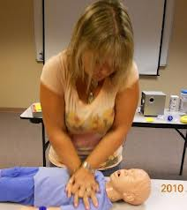
CPR for Infants and Children ( under 8 years old):
Procedure:
Mark the notch with your middle finger.
Place your index finger next to your middle finger.
Place the heel of the same hand next to where the index finger was located.
Depress the sternum 1 to 1 ½ inches with the heel of your hand. Keep your fingers off the chest. Keep the airway open with your other hand.

Slide 14
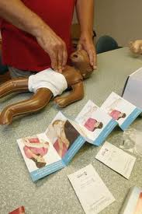
CPR for Infants and Children ( under 8 years old):
Procedure:
Give 80 to 100 compressions per minute. Count out loud in a rhythm ( try 1 and 2 and3 and 4 and 5)
Give a breath after every fifth compression.
Check for a carotid pulse after 20 cycles of 5 compressions and 1 breath.
Activate the EMS system if there is no pulse.
Continue chest compressions and breaths if there is no pulse.
Check for a pulse every few minutes.

