Slide 1
EMERGENCY CARE

Slide 2
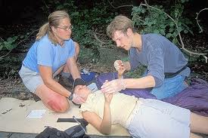
Emergency Care:
It can occur in any where. Knowing what to do can mean the difference between life and death. First aid is the emergency can given to an ill or injured person before medical help arrives. The goals are to:
Prevent Death.
Prevent injuries from becoming worst

Slide 3
General rules of Emergency Care:
Know your limits.
Stay calm.
Practice Standard Precautions and Bloodborne Pathogen Standard.
Check for sign of the life-threatening, breathing, pulse and bleeding.
Keep the person in the position lying down or in the position in which he or she was found.
Perform necessary emergency measures.

Slide 4
General rules of Emergency Care:
Call for help, or tell someone to activate EMS system. An operator will send emergency vehicles and personnel to the scene. Do not hang up and give the following information :
Your location, street address, city, town, etc.
Telephone number you are calling from.
What happened.
How many people need help.
Condition of victims and obvious injuries and any life-threatening situation.
What aid is being given.

Slide 5
General rules of Emergency Care:
Do not removing the person’s clothing unless you have to.. If you must remove clothing, tear or cut garments along the seams.
Keep the person warm. Cover the person with a blanket or other.
Reassure those who are conscious. Explain what is happening and that you call for help.
Do not give the person any food or fluids.
Do not move the person.
Keep bystanders away from the person. Also the person privacy is invaded by onlookers

Slide 6
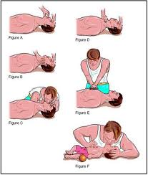
Basic Life Support
When the heart and breathing stop, the person is clinically dead. Blood is not circulated through the body. Body cells do not get oxygen. Permanent brain damage and other organ damage occur within minutes.

Slide 7
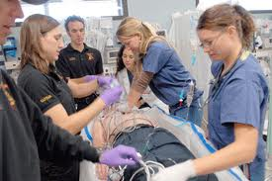
Cardiac Arrest
Cardiac Arrest :The heart and breathing can stop suddenly and without warning. Unexpected and dramatic event . It can occur in any where and in any time, common causes include:
Heart disease.
Drowning.
Electrical shock.
Severe injury.
Airway obstruction
Drug overdose.

Slide 8
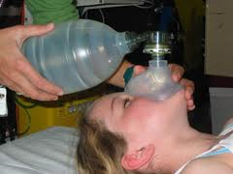
Respiratory Arrest
Respiratory Arrest : It is when breathing stops but the heart still pumps blood for several minutes causes include:
Drowning
Stroke.
Obstructed airway.
Drug overdose
Electrocution
Lightening strike.
Smoke inhalation.
Suffocation
Heart attack
Coma.

Slide 9
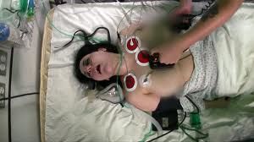
Basic Life Support
BLS involves preventing or promptly recognizing cardiac arrest or respiratory arrest. BSL support breathing and circulation. This life-saving measures require speed ,skill and efficiency. Prompt activation of the EMS system is also part of BLS.

Slide 10
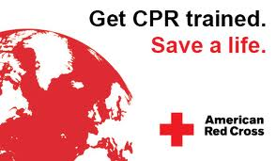
Cardiopulmonary Resuscitation(CPR):
There are three major signs of cardiac arrest- no pulse, no breathing, unconsciousness , the person skin is pale, cool and gray. The person has no blood pressure. CPR must be started as soon as possible to provide oxygen to the brain , heart, kidney , etc. CPR has three basic parts:
Airway
Breathing
Circulation

Slide 11
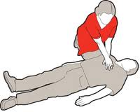
CPR
The person must be supine on a hard, flat surface. The arms are positioned at the sides. If turning is necessary, use the logrolling procedure. The person may have other injuries. Therefore the person is turned as a unit to prevent twisting of the spinal cord.

Slide 12
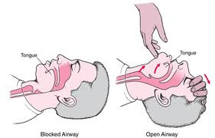
CPR
Airway: The respiratory passages must be open to restore breathing. The airway is often blocked or obstructed during cardiac arrest. The person’s tongue falls toward the back of the throat and blocks the airways. The head-tilt/chin-lift maneuver is used to open airway.

Slide 13
CPR
Airway: The head-tilt/chin-lift maneuver is used to open airway:
Place one hand on the person’s forehead.
Apply pressure on the forehead with the palm to tilt the head back.
Place the fingers of the others hand under the bony part of the chin.
Lift the chin forward as the head is tilted backward with the other hand.

Slide 14
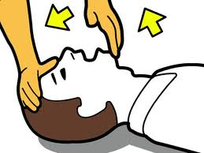
CPR
When the airway is open check for vomitus, loose dentures, or other foreign bodies. These can obstruct the airway during rescue breathing. Remove dentures and wipe vomitus away with your index and middle fingers. Wear disposable gloves or cover your fingers with a cloth. Although you must not waste time, try to protect denture from loss or damage.

Slide 15
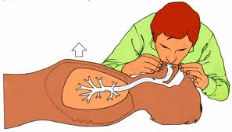
CPR
Breathing: Air is not inhaled when breathing stops. The person must get oxygen. Otherwise permanent brain and organ damage occur. Breathing is done for the person. This is called rescue breathing. Before you start rescue breathing, determine breathlessness . It should take a 3 to 5 seconds to do the following.

Slide 16
CPR
It should take a 3 to 5 seconds to do the following:
Maintain an open airway.
Place your ear over the person’s mouth and nose.
Observe the person’s chest.
Look to see if the chest rises and falls
Listen for the escape of air.
Feel for the flow of air on your cheek.

Slide 17
Mouth to mouth resucitation:
It is the most common method of rescue breathing. The airway is kept open to give mouth to mouth:
Pinch the person nostril shut with the thumb and index finger of the hand on the forehead shutting the nostril prevents the escape of air from the nose.
After taking a deep breath, place your mouth tightly over the person mouth.
Slowly blow air into the person’s mouth. You should see the person’s chest rise as the lungs fill with air.
You should also hear air escape when the person exhales.
After giving a ventilation remove your mouth from the person’s mouth. Then take in a quick , deep breath.

Slide 18
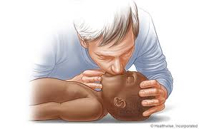
Mouth to Nose:
Indication:
You cannot ventilate the victim’s mouth.
You can not open the mouth.
You can not make a tight seal for mouth-to-mouth resuscitation.
The mouth is severely injured.

Slide 19
Mouth to Nose:
Method:
The mouth is closed for mouth-to-nose resuscitation.
The head tilt/chin-lift method is used to open the airway.
Pressure is placed on the chin to close the mouth.
To give the ventilation, place tour mouth over the person’s nose and blow air into the nose.
After the ventilation, remove your mouth from the person’s nose.

Slide 20
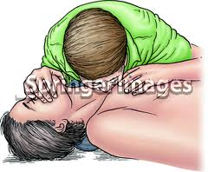
Mouth to Stoma:
Method:
Some people breathe through openings in their neck.
They need mouth to stoma ventilation during cardiac or respiratory arrest.
You will seal your mouth around the stoma and blow air into the stoma.
Always check if the person has stoma.

Slide 21
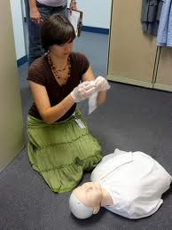
Breathing with Barrier:
Barrier devices prevent contact with person’s mouth and blood, body fluids, secretions or excretions.
Mask devices are available.
The barrier device is placed over the person’s mouth and nose.
Make sure you have a tight seal.
Then breathe into the barrier device.

Slide 22
Breathing:
When CPR is started;
Give two breath at first.
Exhale after each breath.
Then give breaths at rate of 10 to 12 breathes per minute.
During one –rescuer CPR give two breath after every 15 chest compressions.
During two-rescuer CPR give a breath after every 5 chest compressions.

Slide 23
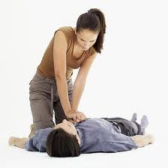
Circulation:
Blood flow to the brain and other organs must be maintained, otherwise permanent damage results. The heart is stopped beating in cardiac arrest. Therefore blood must be pumped through the body in some other way. Artificial circulation is accomplished by chest compression. Each chest compression forces blood through the circulatory system.

Slide 24
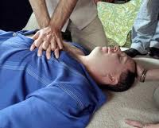
Circulation:
Before starting chest compression determine pulselessness, use the carotid artery on the side near you to check for pulselessness. To find the carotid pulse, place the tips of your index and middle fingers on the person trachea. Then slide your fingertips down off the trachea to the groove of the neck.

Slide 25
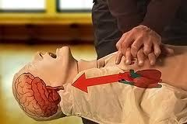
Circulation:
The heart lies between the sternum and the spinal column. When pressure is applied to the sternum, the sternum is depressed. This compresses the heart between the sternum and the spinal column. For effective chest compressions the person must be supine and on a hard flat surface.

Slide 26
Circulation:
Proper hand and body position is important for chest compression:
Use your index and middle fingers to locate the lower part of the person rib cage on the side near you.
Then run your fingers up alone the rib cage to the notch at the center of the chest. The notch is where the ribs and sternum meet.
Place the heel of your other hand on the lower half of the sternum next to your index finger.

Slide 27
Circulation:
Proper hand and body position is important for chest compression:
Remove your index and middle fingers from the notch.
Place that hand on the hand already on the sternum.
Extend or interlace your fingers. Keep your fingers off the chest.
You must be positioned property fro chest compressions.

Slide 28
Circulation:
Proper hand and body position is important for chest compression:
Your elbows are straight.
Your shoulders are directly over the person’s chest.
Exert firm downward pressure to depress the sternum about 11/2 to 2 inches in the adult.
Then release pressure without removing your hands from the chest.
Give a compressions in a regular rhythm.

Slide 29
Performing CPR :
CPR is done when there is unresponsiveness, breathlessness and pulselessness. Basic life support for the adult involves the following sequence:
Determine unresponsiveness . Ask: Are you OK? If there is not response the person is unconscious.
Activate the EMS system immediately if the person is unconscious.
Determine breathlessness. Look at the person chest to see if it raises and fall.. Listen for the escape of air during expiration. Feel for the flow of air. To feel for air, place your cheek near the person’s nose.

Slide 30
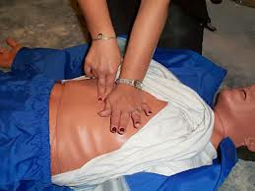
Performing CPR :
Open the airway and give 2 breaths if the person is not breathing.
Determine pulselessness.
Start chest compressions if the person has no pulse.

Slide 31
Adult CPR-One Rescuer:
Procedure:
Check for unresponsiveness.
Activate the EMS system.
Position the person supine..Logroll the person so there is no twisting of the spine. The person must be open a hard, flat surface. Place the person’s arms alongside the body.
Open the airway. Use the head-tilt/chin-lift maneuver.

Slide 32
Adult CPR-One Rescuer:
Procedure:
Check for breathlessness.
Give 2 breath. Each should be 11/2 to 2 seconds long, Let’s the person chest deflate between breath.
Check for pulselessness. Check the carotid pulse for 5 to 10 seconds, Use your other hand to keep the airway open with the head –tilt maneuver.
Give chest compressions if the person has no pulse. Give compressions at a rate of 80 to 100 per minute. Give 15 compressions and then 2 breath.,

Slide 33
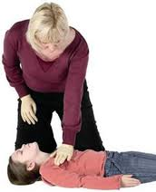
Adult CPR-One Rescuer:
Procedure:
Establish a rhythm and count out loud (1 and 2 and 3 and 4 and 5 and 6 and 7 and 8 and 9 and 10 and 11 and 12 and 13 and 14 and 15)
Open the airway and give 2 breaths
Repeat this step until you have given 4 cycles of 15 compressions and 2 breath.
Check for the carotid pulse(1 to 5 seconds)
Continue CPR if the person has no pulse begin with chest compressions
Continue the cycle of 15 compressions and 2 breath. Check for a pulse every few minutes
Repeat steps 10 and 11 as long as necessary.

Slide 34
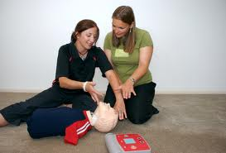
Adult CPR-Two
Rescuer:
Procedure:
Perform one-person CPR until a helper arrives.
Continue chest compressions. The helper says “ I know CPR can I help?”
Indicate that you want help. Ask that the EMS system be activated. If not already done.
Do not stop chest compressions. The helper kneels on the other side of the person. The two-rescuer procedure starts after you complete a cycle of 15 compressions and 2 breaths

Slide 35
Adult CPR-Two Rescuer:
Procedure:
Stop compressions for 3 to 5 seconds. The helper checks for carotid pulse. The helper state “ no pulse”
Perform two person CPR as follow:
The helper give 2 breaths.
Give chest compressions at a rate of 80 to 100 per minute. Count out loud in a rhythm (“1 and 2 and 3 and 4 and 5)
The helper gives a breath immediately after the fifth compression. Pause for the breath. Continue chest compressions after the breath.
A breath is given after every fifth compression.

Slide 36
Adult CPR-Two Rescuer:
Procedure:
Stop compressions after 1 minute. Your helper checks for a carotid pulse. After the first minute, compressions are stopped every few minutes to check for breathing and circulation. Compressions are stopped for only 5 seconds
Call for a switch in positions when you are tired.
Change positions quickly
Helper gives a breath after you give the fifth compression.
Helper moves down to kneel at the person’s shoulder and finds the proper hand position.

Slide 37
Adult CPR-Two Rescuer:
Procedure:
You move to the person’s head after giving the fifth compression.
Check for a carotid pulse(3 to 5 seconds)
Say “No pulse”
Give 1 breath before your helper starts chest compression
Give 1 breath after every fifth compression.
Switch positions when the person giving the compressions is tired. Check for a pulse and breathing at every position change.

